Slide 1



Predicting Stock Prices with Machine Learning
Erik Buinevicius

Slide 2

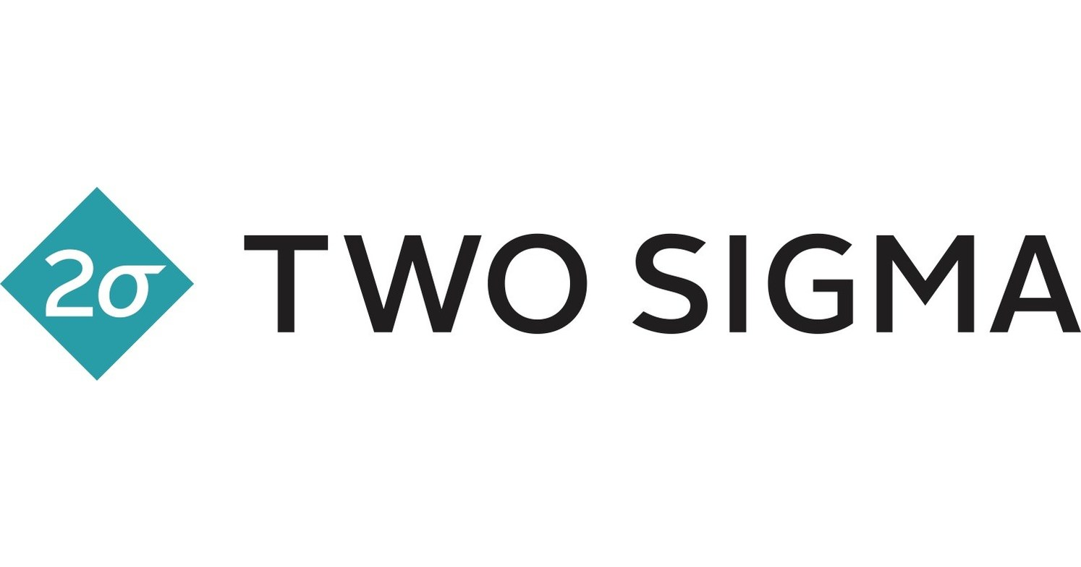
Introduction
Trillions of dollars worth of assets are exchanged on stock markets around the world every day
Quantitative trading firms historically outperform the market year after year thanks to their algorithmic approach
If we can accurately predict whether a stock will move up or down over 50% of the time, we can theoretically make money over a long period of time
Alternatively, we can attempt to forecast the price of a stock, and if we are accurate within a certain error, we should also be able to outperform
Notes:
Don’t need specifices on renaissance

Slide 3
Questions to Explore
Can we accurately forecast what the price of a stock should be based on historical trends and moves using machine learning?
Can we accurately predict whether a stock will move up or down tomorrow?
What machine learning models perform the best and what features are most relevant when working with historical financial data?
Plenty of work exists exploring these types of questions, and while quantitative firms who outperform the market by dozens of percentage points have much more sophisticated models than I will be able to produce, it will still be interesting to see what we can do within the allotted time period for this project.
Notes:
Don’t read paragraph

Slide 4
Related Works
Shen & Shafiq “Short-term stock market price trend prediction using a comprehensive deep learning system” (2020)
Stock predictions surrounding 3558 Chinese stocks
LSTM prediction of simply up or down (0 or 1)
Focused heavily on complex recursive feature engineering
Bhandari, Rimal, Pokhrel, Rimal, Dahal, Khatri “Predicting stock market index using LSTM” (2022)
S&P 500 single-day prediction
Used ~15 features such as VIX, 10-Year Treasury, as well as employment rates, U.S. dollar, and technical averages
Will use some ideas from this research paper
VIX, Interest Rate data
Single-layer LSTM

Slide 5
Working With the Data
Historical data for various financial entities can easily be gathered from Yahoo Finance
https://finance.yahoo.com/
Historical data can be downloaded directly into a dataframe using Python’s pandas datareader module
We can also download the data in csv format and upload it to a dataframe manually
Historical price data for companies will be important, but what else?
CBOE Volatility Index (VIX)
Measure of overall expected volatility in the market (higher generally means more uncertainty)
10-year Treasury Note Yield (TNX)
Current yield of a 10-year government treasury bond
Proxy for interest rates
Volume data
Number of securities traded during a given period
Notes:
Don’t focus on first bullet

Slide 6
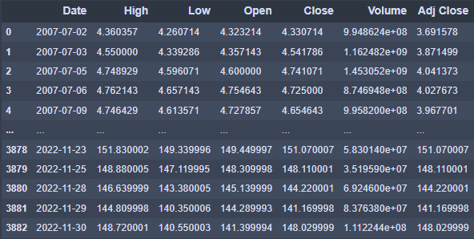
Working With the Data
Date field can be used to join various datasets together
Since the data we are working with is time-series data,
outliers are unlikely to hinder research
Average of surrounding days can be used to fill empty values
Imputation
To tell whether a stock is up or down on the day, we can
engineer features such as “NextDayChange,” which looks
one day ahead in data to see whether it will move up or
down given the day’s known conditions.
This and similarly engineered features will be relevant, especially for our classification model

Slide 7
General Feature Considerations
Will normalize all data using min-max scaling between 0 and 1
Not too many outliers and we want to consider them as they are often the most important days in the market
Data we will be normalizing are all positive numbers (price values for the most part)
Will be using SPDR S&P 500 ETF Trust (SPY) specifically to train the model, since it tracks the overall market
Model will hopefully be transferrable to most individual stocks
Where will we start our historical data from?
January 1, 2006
Prior to the great recession
Will allow the model to feel out multiple bear markets as well as bull runs
Stocks seemingly re-rated in 2021 post Covid
Can test shorter-term LSTM models on this period, with shorter windows

Slide 8
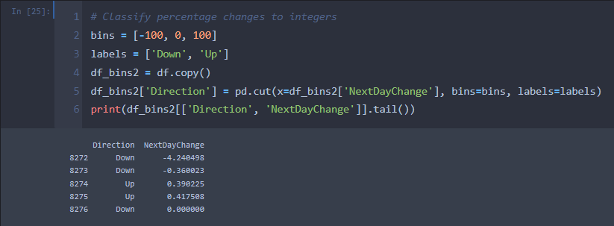

Feature Engineering
Engineered a new feature for the next day’s % change (tomorrow’s closing price / today’s closing price)
Can then use NextDayChange value to turn this into a classification problem
Direction variable: NDC > 0 → ‘Up’, NDC < 0 → ‘Down’

Slide 9
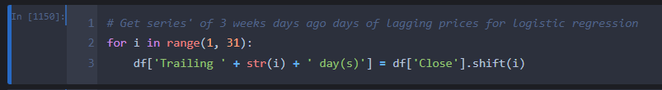
Feature Engineering
Engineered features for 30 trailing days of prices
These will be used in our Logistic Regression model
.shift() method in pandas becomes useful, as it allows us to move rows forward or backward in the dataframe

Slide 10
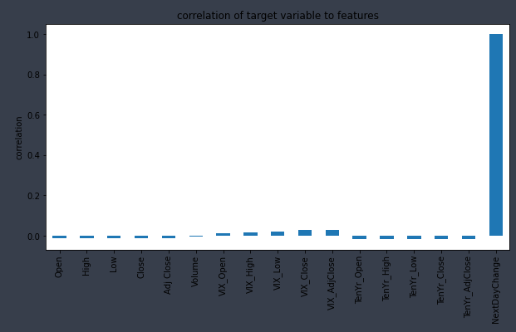
Feature Evaluation
The most strongly correlated features are VIX_Close and VIX_AdjClose
This makes sense because a large increase in the VIX throughout a day often indicates a lot of volatility on the horizon
Surprisingly, volume and price data are not as relevant as most of the VIX features
This means we are going to eliminate these irrelevant features to prevent unnecessary noise for our model

Slide 11
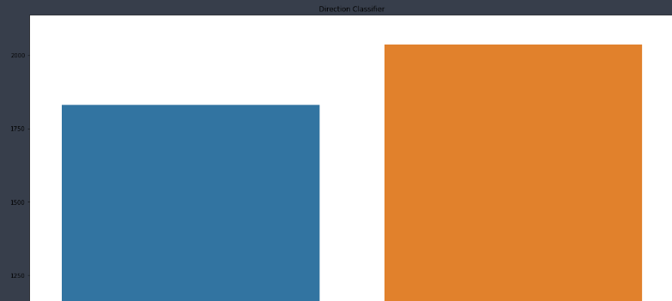
Data Visualization
NextDayChange
Down Days
Up Days

Slide 12
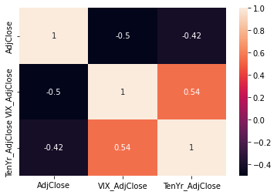
Data Visualization
LSTM Model Inputs
Notes:
Don’t need to talk about

Slide 13
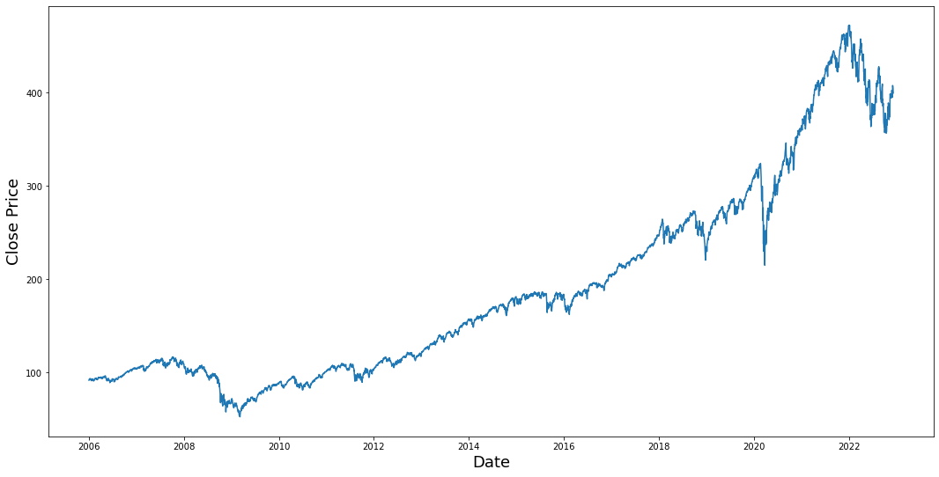

Data Visualization

Slide 14
Model Development
Three different models will be explored for this project
ExtraTreesClassifier (chosen by AutoML TPOTClassifier)
Logistic Regression
Long Short-Term Memory (LSTM) → Classical method for stock price prediction
This model will comprise most of our exploration and development time spent
A variation of a recurrent neural network that can learn long-term trends while also accounting for more recent short-term patterns
Solution to the exploding/vanishing gradient problems present in recurrent neural networks
Gradient “vanishes” → becomes extremely small as the algorithm propogates backwards, meaning weights near input layers are essentially unchanged
Gradient “explodes” → becomes extremely large as algorithm propogates backwards, meaning gradient descent diverges
Notes:
Don’t spend too much time on LSTM here

Slide 15
Model Training 1: AutoML Model
First model that I explored
Decided that we could use obvious features such as stock price, as well as more nuanced features including VIX data (CBOE volatility index) and government bond data (10-year treasury note)
Using python tpot library for the TPOTClassifier tool which automatically determines the best pipeline for classification problems
Training takes significantly longer than traditional TensorFlow models, since the entire pipeline must be operated on
Makes it hard to test a large amount of hyperparameters

Slide 16
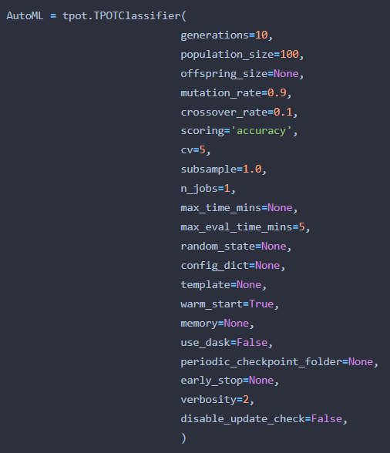
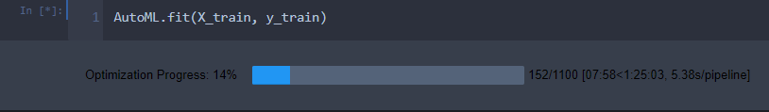

Model Training 1: AutoML Model

Slide 17
Model Evaluation 1: AutoML Model
TPOT results in a different classifier model almost every time (KNeighborsClassifier, ExtraTreesClassifier…)
We can evaluate the model on our test data, since for this model the train/test split was performed randomly
(time-series data is not relevant here)
Confusion matrix was used, since it allows us to easily view the number of correct up/down day predictions
Model did not perform well

Slide 18
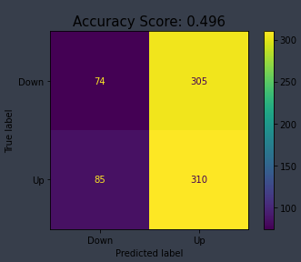
Model Evaluation 1: AutoML Model

Slide 19
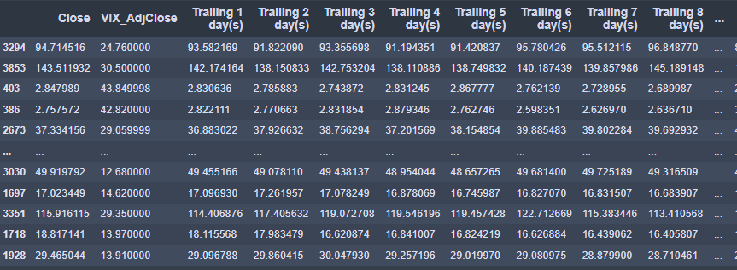
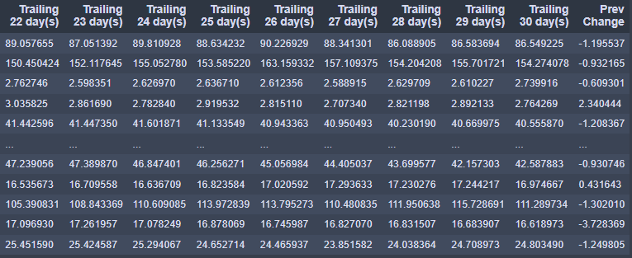
Model Training 2: Logistic Regression Model
Selecting random, completely uncorrelated features did not seem to work for the AutoML model
What if we instead take trailing price data and see if we can predict the next day’s direction with logistic regression
Can use scikit-learn LogisticRegression module
Uses a series of unrelated features to predict a binary outcome
In our use case, we will again be predicting either an ‘Up’ or ‘Down’ move of a stock on a given day

Slide 20

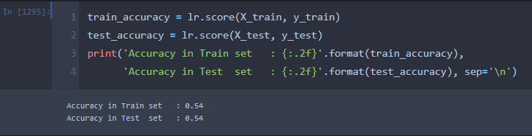
Model Training 2: Logistic Regression Model

Slide 21
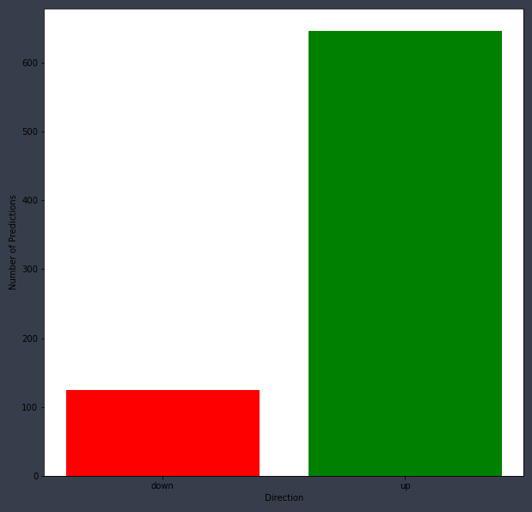
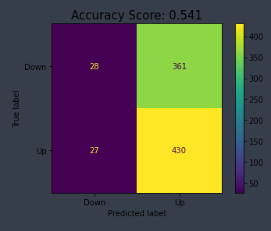
Model Evaluation 2: Logistic Regression Model
Model predicts a lot more up days than it predicts down days
Likely due to the fact that data is already skewed towards up days
Model needs solid conviction to predict a down day
Still performs well, with 54% accuracy
Notes:
Usefulness of model

Slide 22
Model Training 3: LSTM Model
Long Short-Term Memory, or LSTM, works specifically with time-series data
Uses sigmoid and tanh activation functions (0, 1) vs (-1, 1)
Three gates
Forget gate → What percentage of long-term memory we will remember
Input gate → Update to long-term memory (potential memory * % potential memory to use)
Output gate → New short-term memory (output from entire LSTM unit)
Train and test sets will have to be split so that items are near each other
First 75% of days are training, final 25% are testing

Slide 23
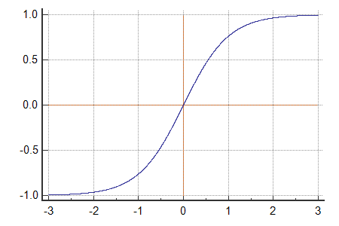
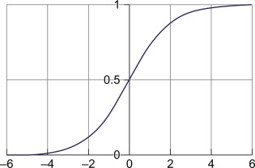
Activation Function Comparison
Tanh function
Sigmoid function

Slide 24
LSTM Model Parameters
Units
Integer value
Represents the dimension of inner cells in each LSTM layer (neurons)
More units means training is going to take longer (need to find a good balance)
Return_sequences
Indicates whether all hidden states should be returned from the LSTM
Should be set to True for all layers prior to the final LSTM layer (future layers need to know the history)
Ended up using single layer LSTM
Dropout Layers
Float between 0 and 1
Probability of randomly setting an input element to 0
Helps prevent overfitting
Window used for LSTM
This is the number of days that the model will look back when predicting the next day’s stock price
Will have to explore different windows to see what performs best

Slide 25
LSTM Model Parameters cont.
Epochs
Number of times that the model will work through the entire dataset
Greatly affects training time
Batch size
Number of samples that are processed by the model before it is updated
Should be a power of 2
Optimizer: ‘Adam’
Extension of Stochastic Gradient Descent (SGD)
Default learning rate of 0.001
Combines AdaGrad and RMSProp optimizers
Adaptive Gradient Algorithm
Root Mean Square Propagation
Generally accepted as one of the best optimizers

Slide 26
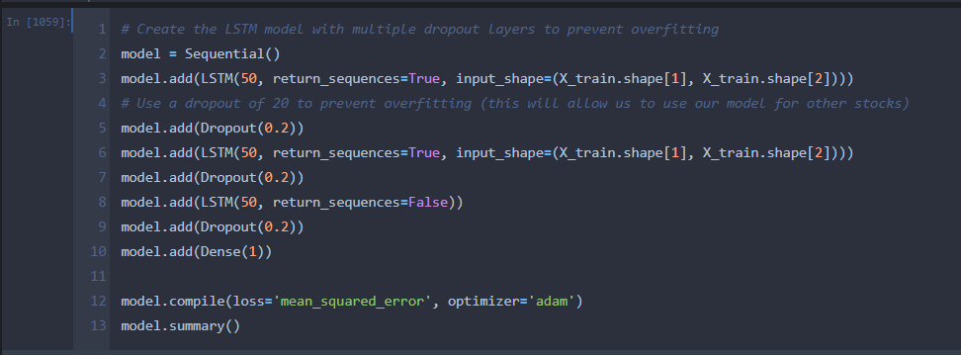
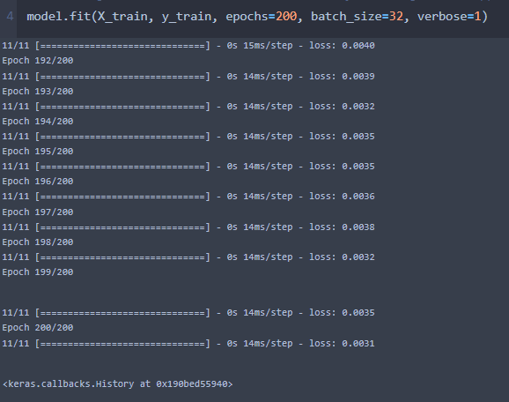
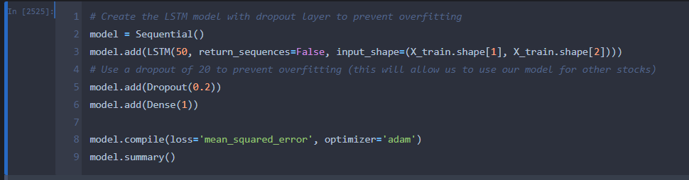

Slide 27
Model Parameter Experimentation
60-day look-back:
3 25-unit LSTM layers, 3 20% dropout layers: ~9% RMSE
3 25-unit LSTM layers, 3 40% dropout layers: ~11.5% RMSE
3 50-unit LSTM layers, 3 40% dropout layers: ~8% RMSE
3 50-unit LSTM layers, 3 20% dropout layers: ~4.9% RMSE
3 100-unit LSTM layers, 3 30% dropout layers: ~4.6% RMSE
180-day look-back:
Tested the standard model from before (3 50-unit layers, 20% dropout) with a 180-day window
Resulted in a larger RMSE (~4.9%)
Training took much longer for an error that was actually larger, so I decided that the 180-day window was too long
50-day look back:
3 50-unit LSTM layers, 3 20% dropout layers: ~7% RMSE
1 50-unit LSTM layers, 1 20% dropout layer: ~2.2% RMSE
Likely so good due to overfitting
1 50-unit Bidirectional LSTM layer, 1 20% dropout layer: ~9.5% RMSE
Bidirectional is resulting in future prices being taken into account, so when a stock goes up the projection knows it is going up and therefore overestimates the price (larger magnitude of moves)

Slide 28
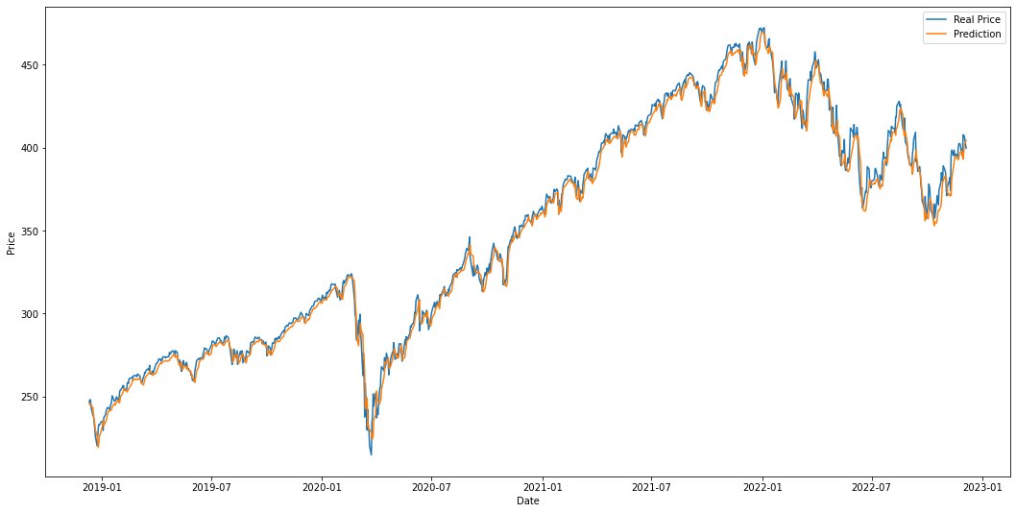
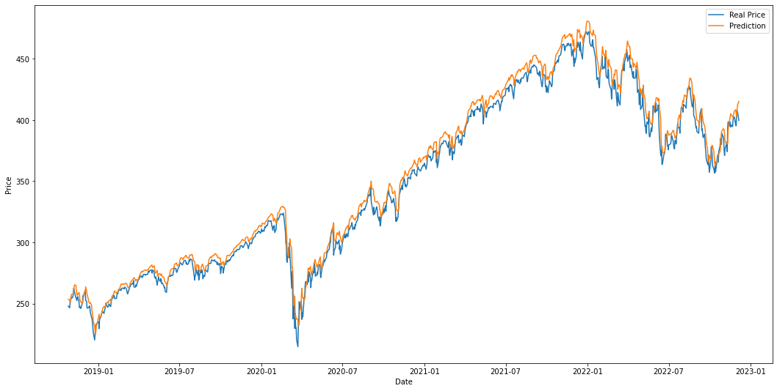
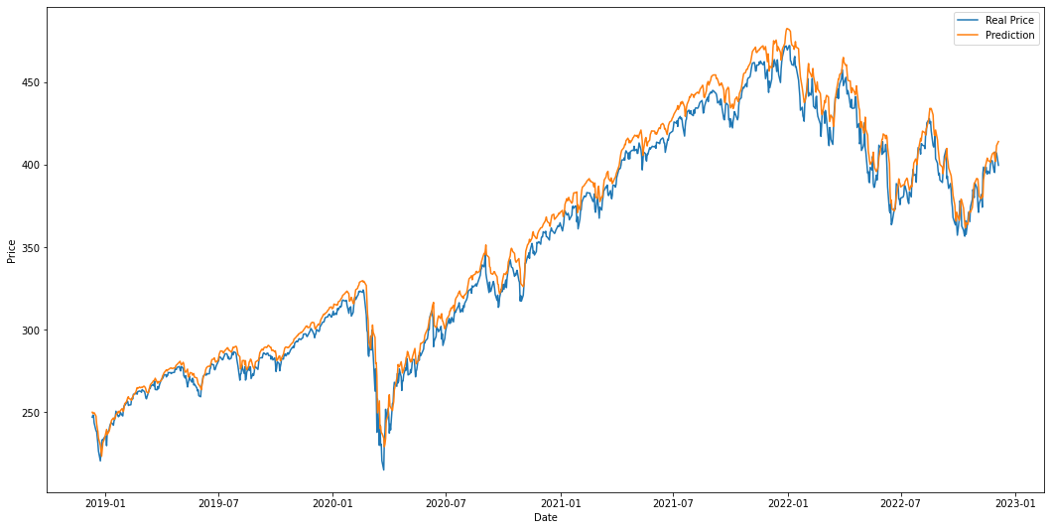
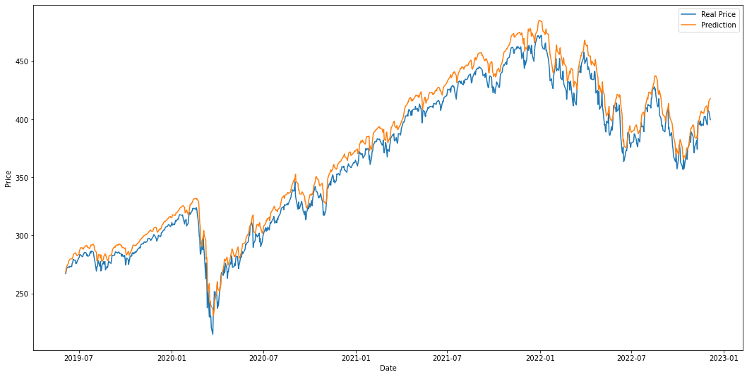
Model Validation
50-day LSTM (1.3% MSE)
30-day LSTM (1.9% MSE)
60-day LSTM
(2.0% MSE)
180-day LSTM
(~2.6% MSE)

Slide 29
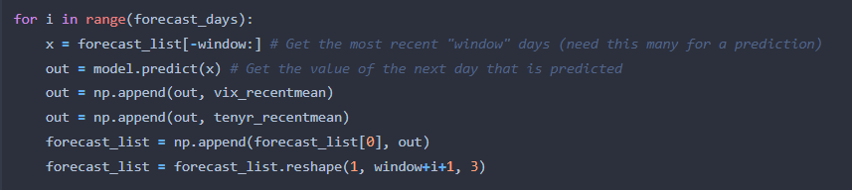
Forecasting
Now that we have predicted the stock price on our test data with solid accuracy, we can forecast the future stock price
Forecast will use model’s output as future inputs
This means our forecast will have a lot of uncertainty, as the inputs are not necessarily truth
Will use average of recent 50 days of VIX and Treasury data for our forecast (best performing model)
Number of forecast days should be significantly smaller than window
Need to build our most recent input of ‘window’ days by appending the output each time

Slide 30
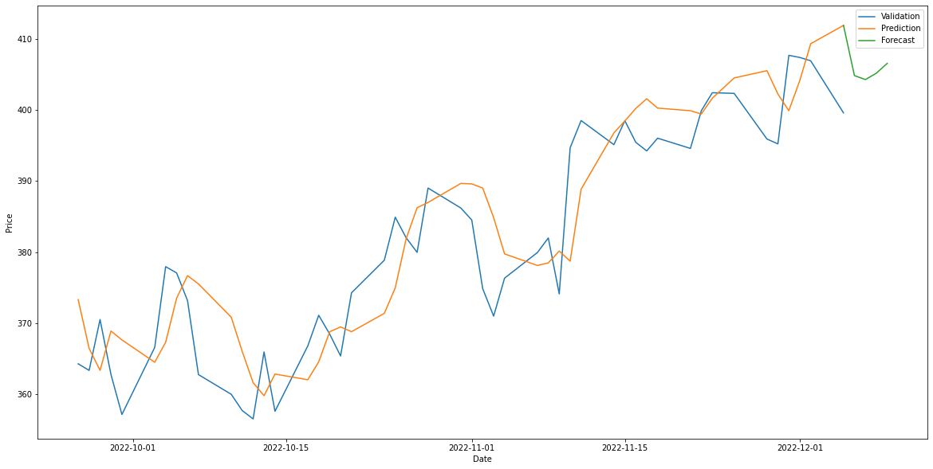
Forecasting cont.
SPY

Slide 31
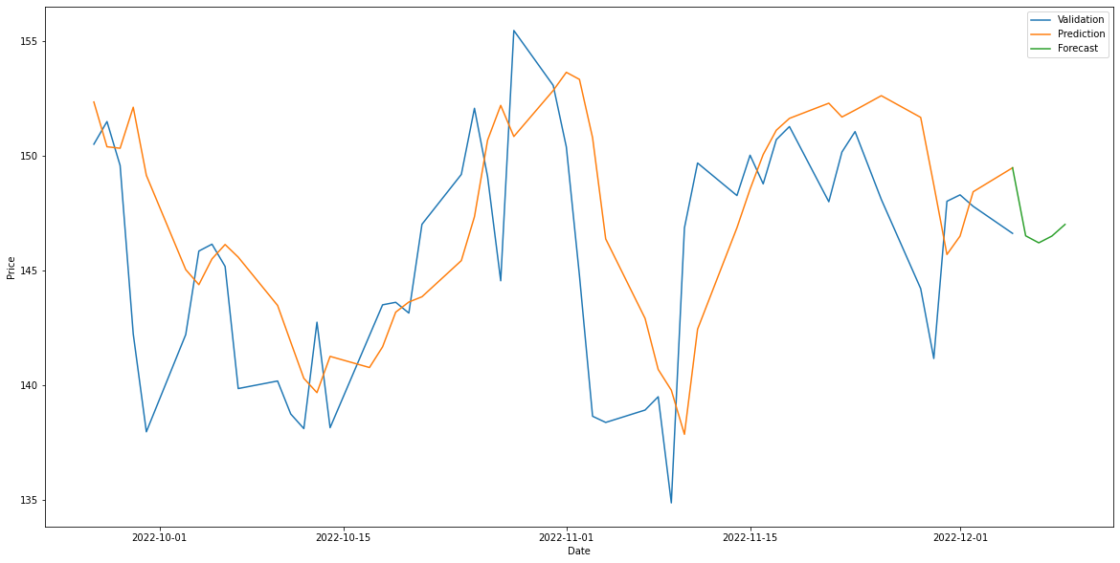
Forecasting cont.
AAPL

Slide 32
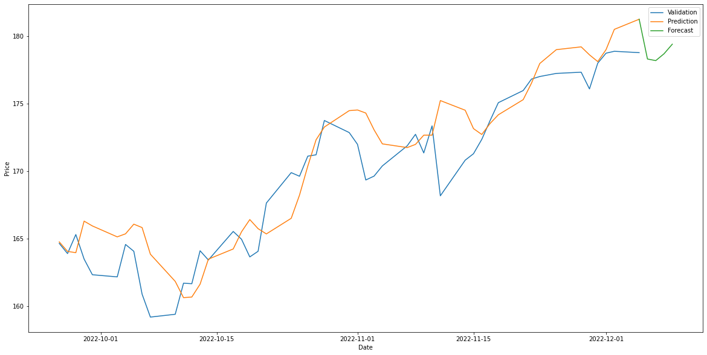
Forecasting cont.
JNJ

Slide 33
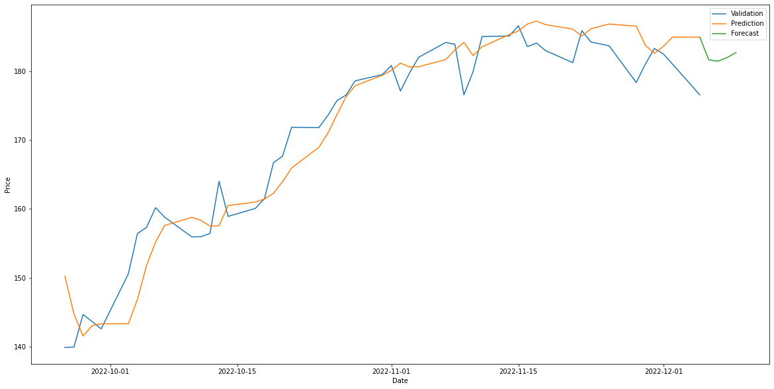
Forecasting cont.
CVX

Slide 34
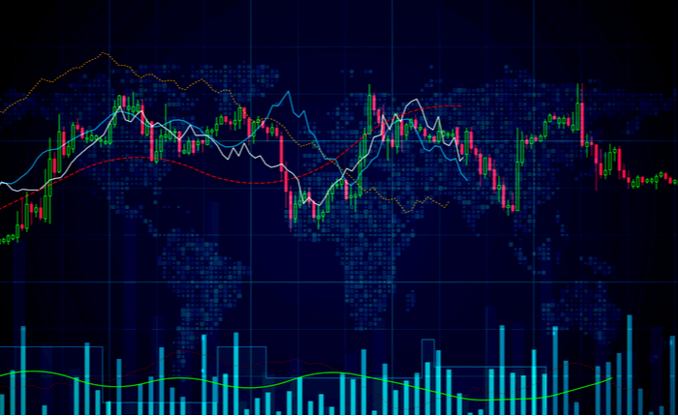
Future Direction
Building a trading algorithm on top of our forecast (if forecast is 10% above price, for example, then we should trust the algorithm and buy)
Would need to back test this
Improvement of forecasting
Forecast VIX/10-Year
Commodities
Oil
Natural Gas
Gold
Technical indicators
Develop models for specific companies

